Slide 1
Chapter04 WEB SERVER
Session 03
Security
On Web Server

Slide 2


OBJECTIVES FOR TODAY
Understanding how HTTP and HTTPS protocol works
Identify the important of security on web server
Explain how encryption works
Understanding some kind of cyber attacks on web application

Slide 3
HTTP vs HTTPS

Slide 4



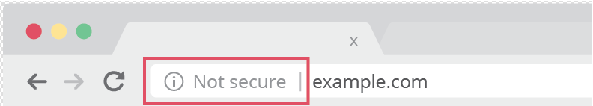
EXPLAIN
HTTP protocol fundamental
5 MIN
HTTP
Stand for Hypertext Transfer Protocol ( http:// )
Use for web communication (information exchange on the Internet)
Use TCP port 80 by default
Requests sent via URL (website address)
Clear text and stateless (unencrypted)
Less secure (vulnerable to hackers)

Slide 5
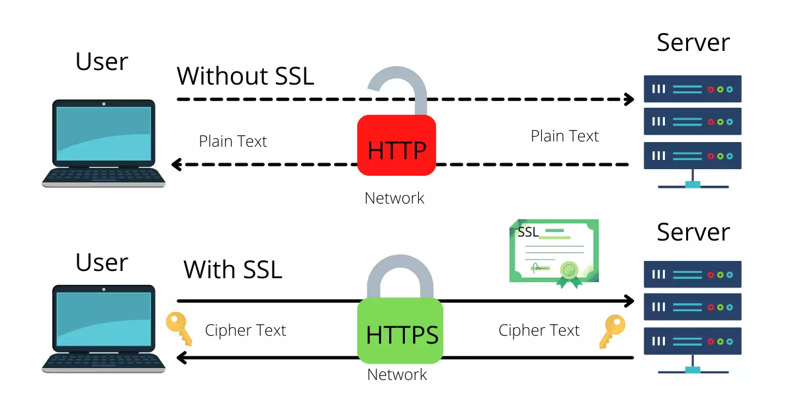

Slide 6

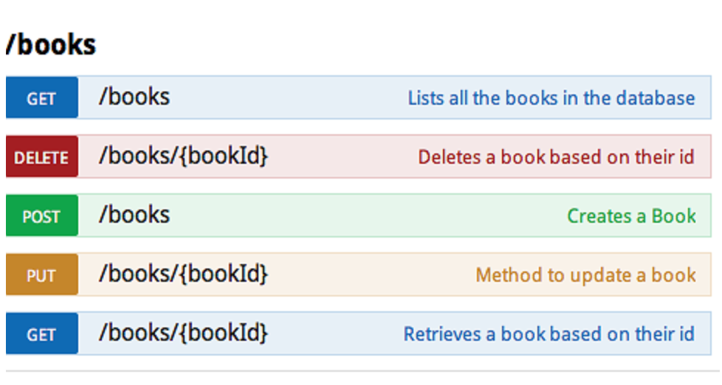
EXPLAIN
HTTP Request Methods
5 MIN

Slide 7
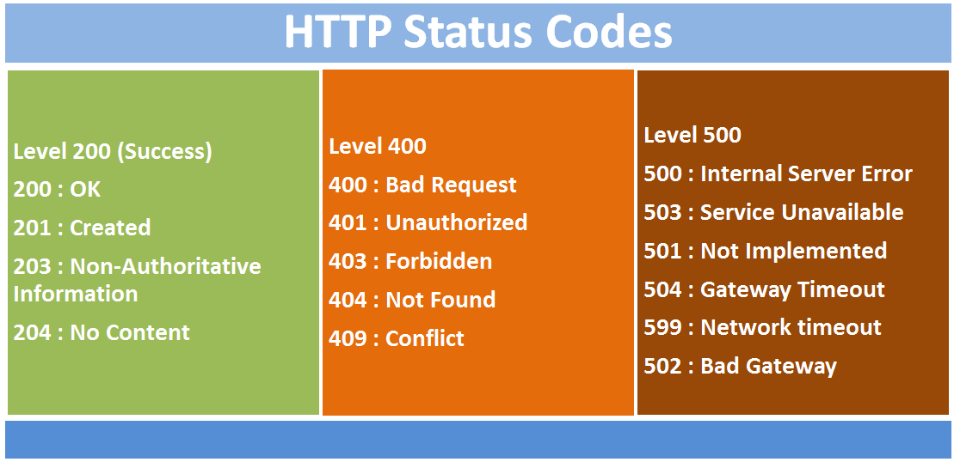
EXPLAIN
5 MIN

Slide 8


DEMO
5 MIN
Wireshark – Analyst packets

Slide 9
EXPLAIN
HTTPS protocol fundamental
5 MIN
HTTPS
Stand for Hypertext Transfer Protocol Secure
Encrypt information sent between browser and web server (secure)
Use TCP port 443 by default
HTTPS make hackers hard to break the connection and steal the personal data

Slide 10


ENGAGE
Why HTTPS?
3 MIN
What make HTTPS secure?
How encryption works?

Slide 11
Encryption (SSL/TSL)

Slide 12
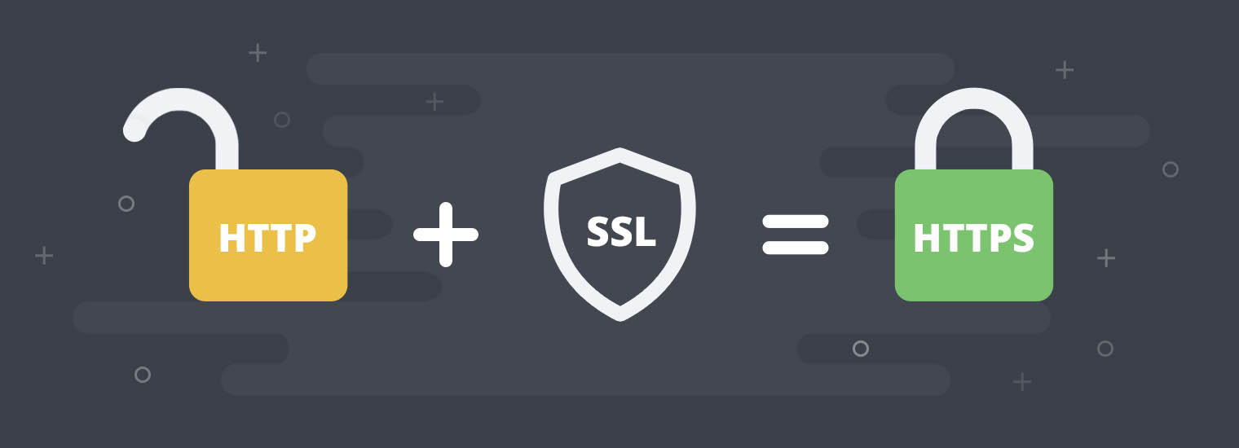
EXPLAIN
SSL/TLS Protocol
5 MIN
SSL (Secure Socket Layer) was developed by NETSAPCE in 1990s
SSL was rebranded as TLS (Transport Layer Security)
SSL is a protocol that is being used to provide secure communications (encryption) to a computer network.

Slide 13
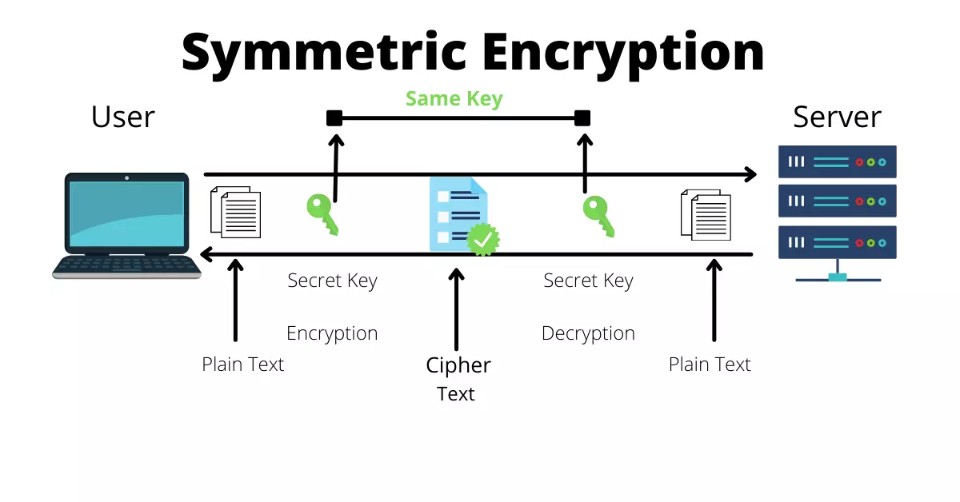
EXPLAIN
Encryption Methods
5 MIN

Slide 14
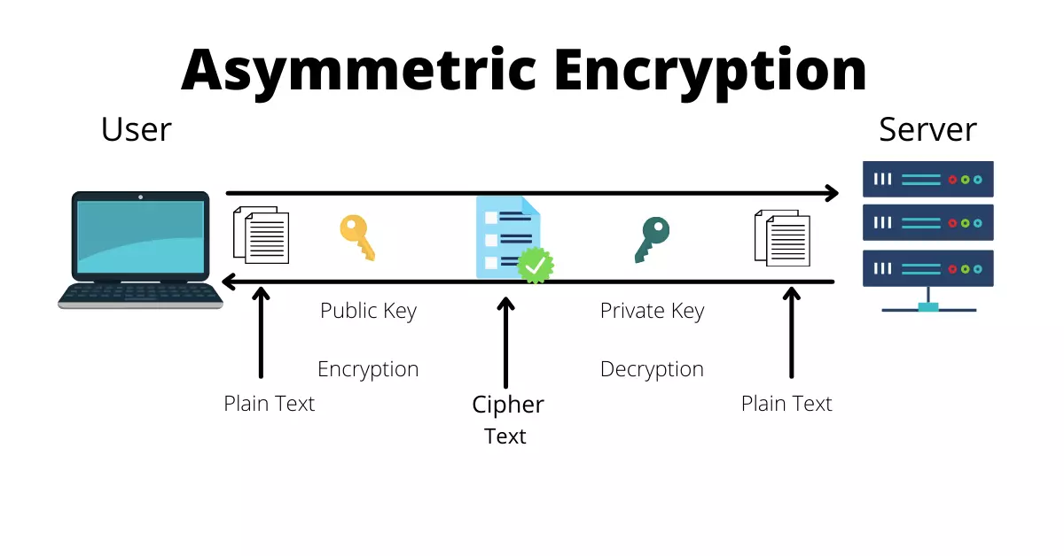
EXPLAIN
Encryption Methods
5 MIN

Slide 15
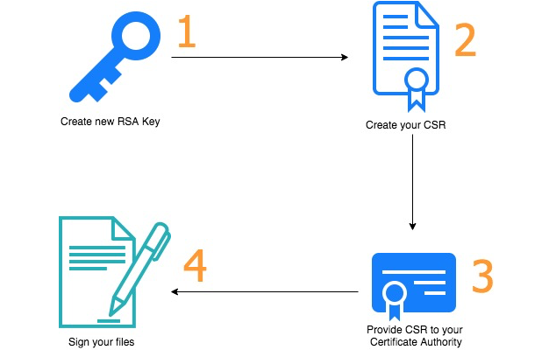
EXPLAIN
Certificate Authority (CA)
5 MIN
SSL Certificate is used to identify on website to be trusted.
Certificate authority (CA) is an organization that acts to validate identities and bind them to cryptographic key pairs with digital certificates.
List of CAs:
Symantec
Geo Trust
DigiCert
GoDaddy
SSL.com

Slide 16
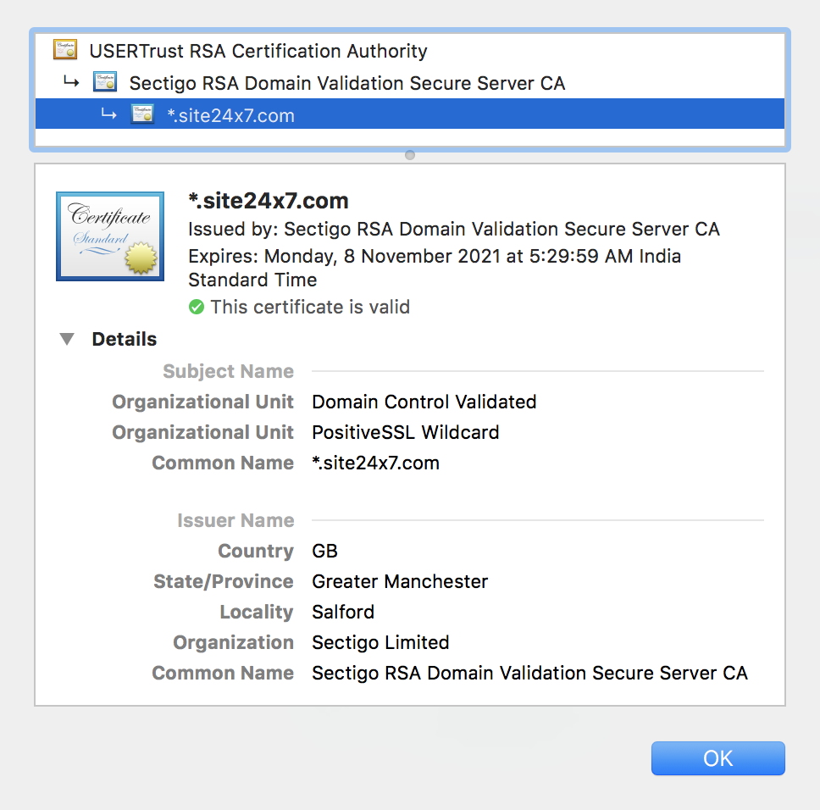
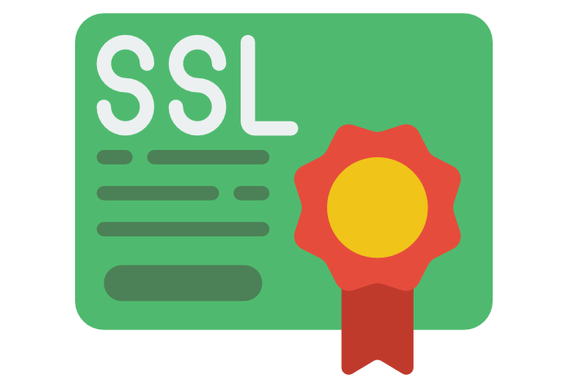
Checking the detail information on certificate.

Slide 17
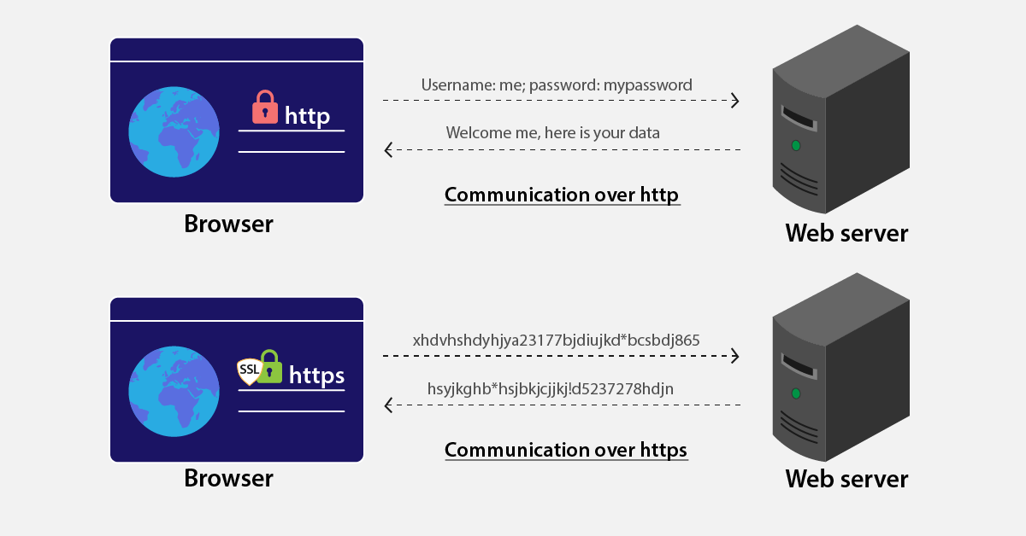
HTTPS Connection

Slide 18
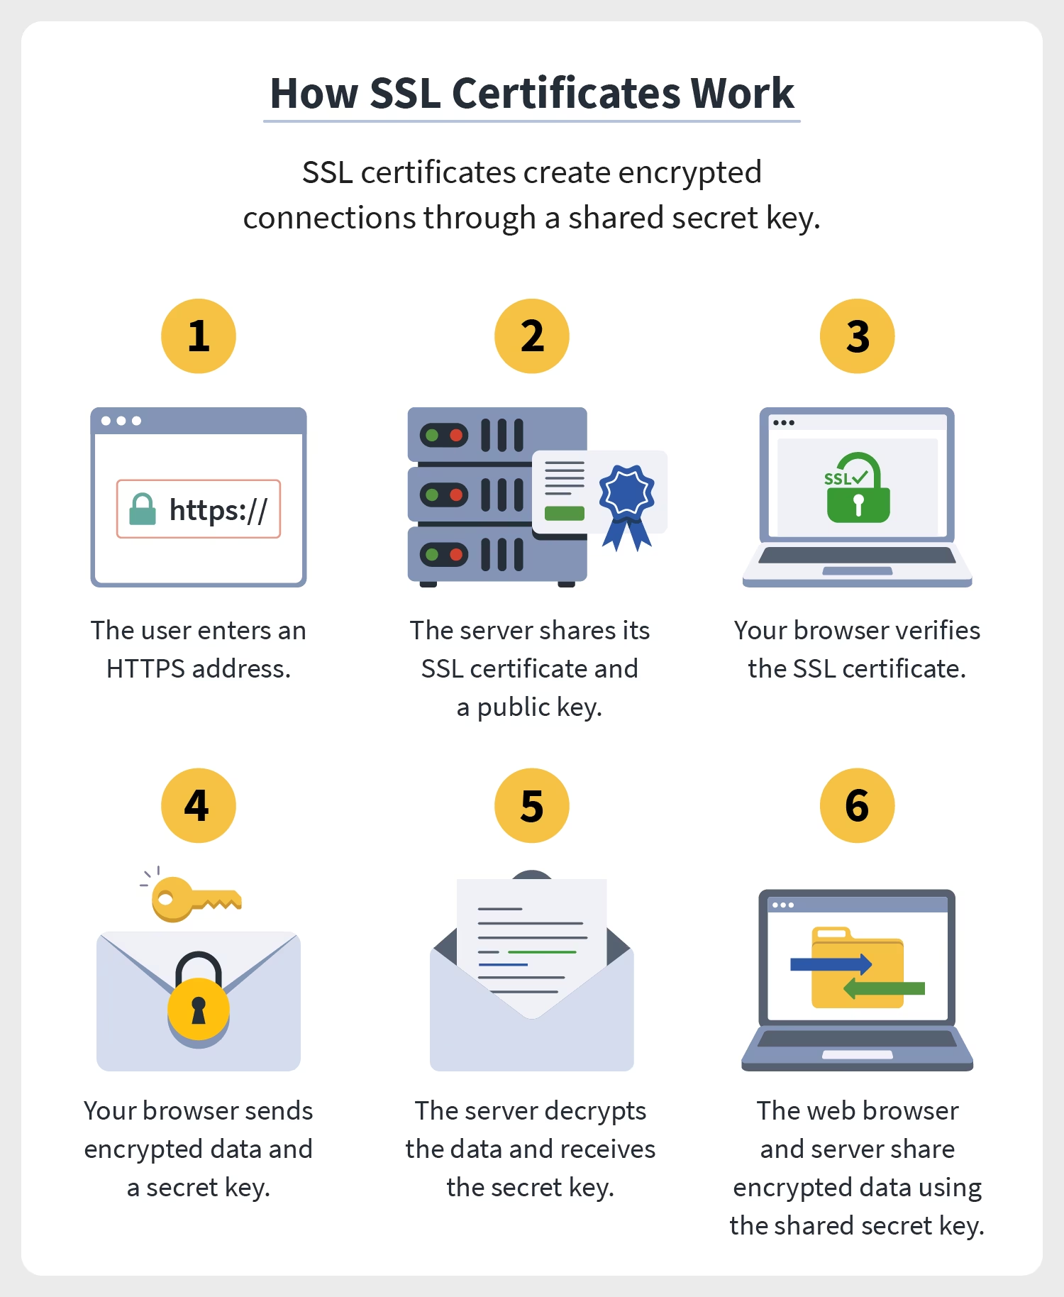
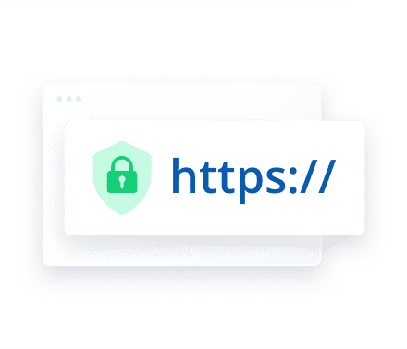

HTTPS Connection

Slide 19
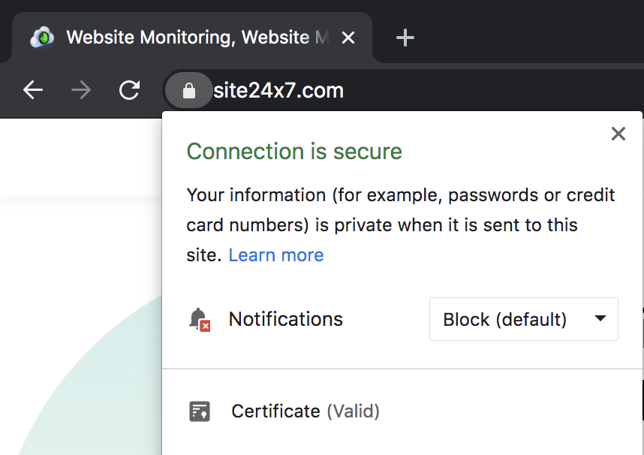
EXPLAIN
How to implement HTTPS?
5 MIN
Purchase SSL/TLS certificate from a trusted Certificate Authority (CA)
Configure hosting with SSL certificate
Redirect all internal links from HTTP to HTTPS
Once you done, your site will look like this:

Slide 20

Cyber Security Threats you should know as a Web Developer

Slide 21

ACTIVITY
Let’s find out!
5 MIN
ACTIVITY 1
1. What is Cyber Attack?
2. The reason of attack
3.Type of attacks

Slide 22

EXPLAIN
Cyber Attacks on Web Application
10 MIN
Broke authentication
Broke access control
Session hijacking attack
Security misconfiguration
Injection
Cross site scripting
Sensitive Data Exposure
Notes:
- Injection : attacker successfully submits invalid data to the application.
Ex. SQL injection.
- Broken Authentication : web application's authentication system having weak
security feature. Ex. "credential stuffing"
- Sensitive Data Exposure : attacker gain unauthorized access and compromise
data that should be private (lack of encryption). Ex. intercepting & hijacking.
- Broke Access Control : attacker be able to give them access to content they not
be able to, such as administrative tools.
- Security Misconfiguration : is the vulnerability that make web application unsecure.
Ex. Weak password, using unsecure protocol (HTTP), default password, unpatched software.
- Cross Site Scripting (XSS) : attacker added malicious code or script to a webpage through
site's input (comment section, form submissions, etc).
- Session hijacking attack : he attacker takes advantage of the active session between the victim and the server and intervenes in the session of another user

Slide 23

Protect your content on Web Server

Slide 24
EXPLAIN
Security Tips for Web Developers
10 MIN
Understand the criteria of strong password
Limiting the number of authentication attempts
Implement the principle of least privilege
Using SSL certificates (HTTPS)
Use the safer frameworks
Configuration checking regularly & software up to date
Validate input data
Backup

Slide 25


